Slide 1
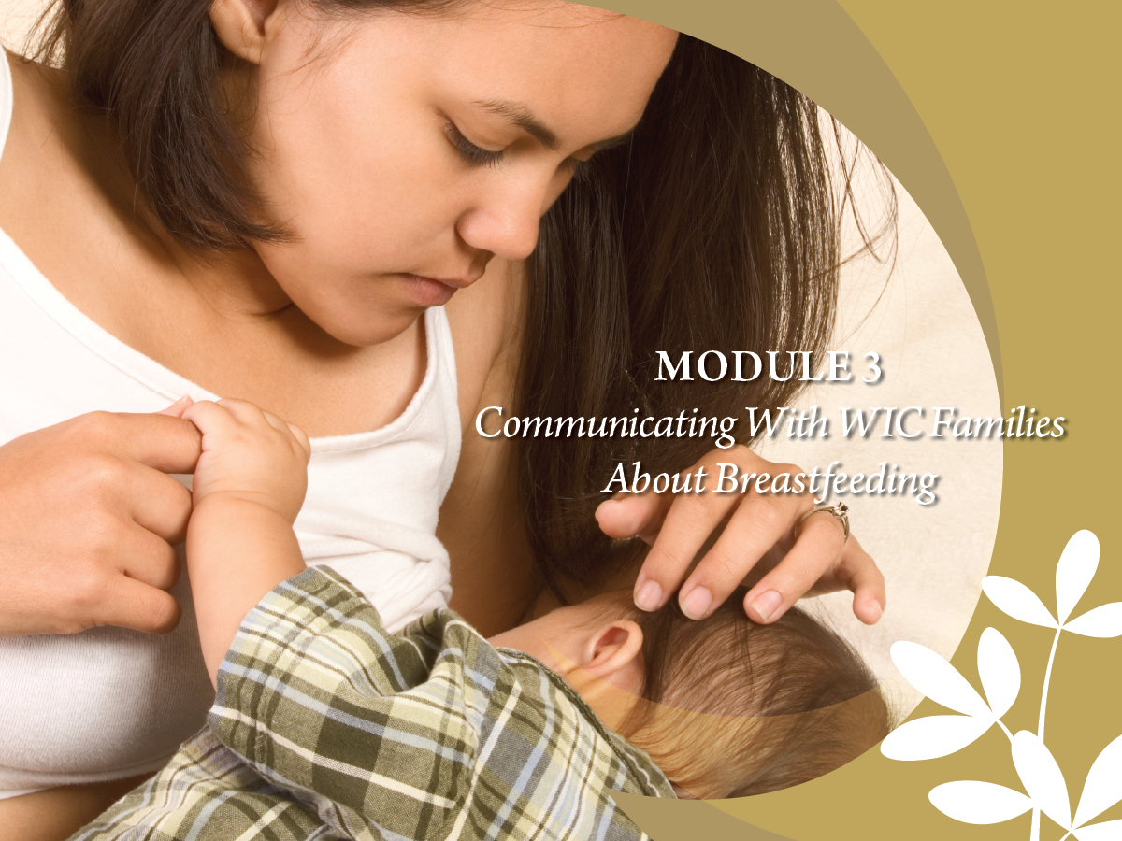

Slide 2
Core Competency
Develops rapport and fosters open dialogue to successfully communicate with mothers and their families about breastfeeding.

Slide 3
Learning Objectives
Identify rapport building techniques that establish a positive relationship with pregnant or breastfeeding mothers.
Demonstrate the ability to use participant-centered techniques (e.g. active listening, reflection, and affirmation) when communicating with or counseling pregnant or breastfeeding mothers.

Slide 4

Planting Seeds

Slide 5
Knowledge Isn’t Always Enough
People do not always adopt healthy behaviors based on information alone
Effective counseling principles help mothers explore ways to work breastfeeding into their lives

Slide 6
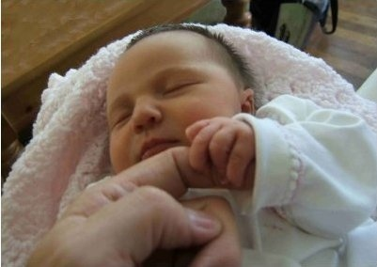
First Things First: Connection Before Content
“People don’t care what you know
until they know you care.” --Anonymous

Slide 7
Tools for Connection: Active Listening Skills
Use open-ended questions and probes to explore concerns
Affirm feelings
Educate to target concerns
Information comes last

Slide 8
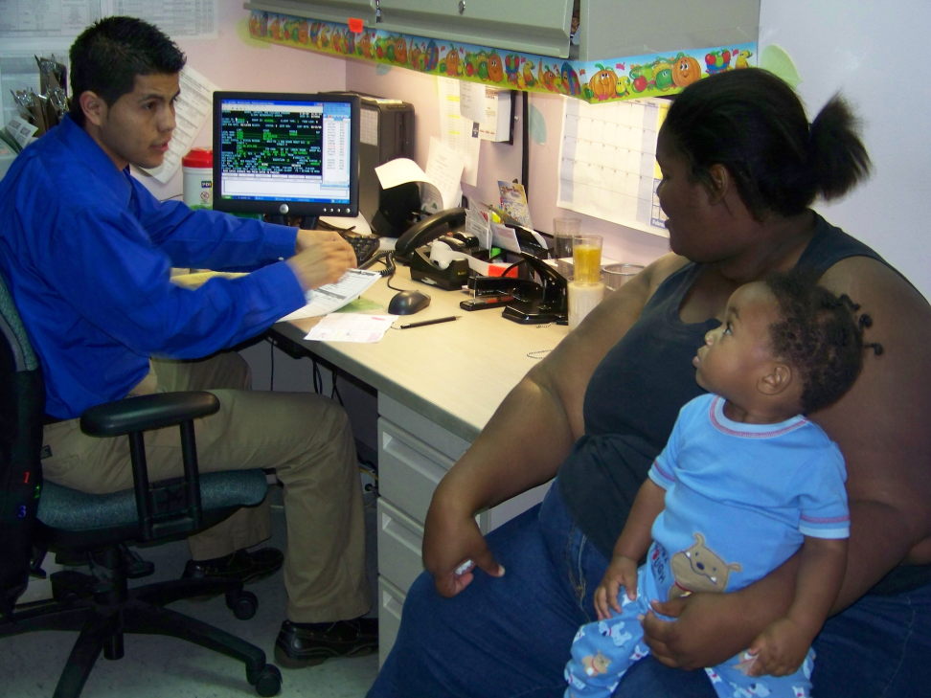
Step One: Open-Ended Questions
Help mothers feel safe sharing thoughts and feelings
Avoid making clients feel interrogated
Have no right or wrong answer
Build trust and openness
North Miami Beach WIC, Miami, FL

Slide 9
Examples of Open-Ended Questions
WHAT
What has your mother told you about breastfeeding?
What paperwork did you bring with you today?
HOW
How do you feel about breastfeeding?
How is breastfeeding going?
TELL ME
Tell me why you feel you will need formula.
Tell me about a typical day at your house.

Slide 10
Open or Closed?
Do you work?
How do you feel about that?
Have you started feeding your baby solid foods yet?
Are you going back to school?
What options have you already tried?
What can you tell me about your pregnancy?
What has your partner said about breastfeeding?
How many times a day does the baby feed?
What’s a good plan for you?

Slide 11

Practice
Are you going to breastfeed or bottlefeed?
Have you talked to your mother about breastfeeding?
Are you going back to work after the baby is born?
Have you gone to a prenatal class yet?
Do you have other children?
Are you going to room in with your baby at the hospital?

Slide 12

Using Open-Ended Questions in WIC
Handout 3.1: “Let’s Practice Open-Ended Questions”

Slide 13

Digging for More Information
Probes:
Extending
Clarifying
Reflecting
Redirecting

Slide 14
Extending Probe
What else have you heard about that?
How do you feel about what she said?
Tell me more about that.

Slide 15
Clarifying Probe
Do you mean breastfeeding will be painful?
What part about breastfeeding do you think will be most uncomfortable?
When you say, “It’s too hard” do you mean it will be too hard to learn how to breastfeed?
Are you concerned breastfeeding will be embarrassing to you or to someone who might see you?

Slide 16
Reflecting Probe
So you’re saying you don’t think you can breastfeed.
You think your mother won’t approve of breastfeeding.
You feel he is possessive of you and will not like it if you pay more attention to the baby.

Slide 17
Redirecting Probe
I can see you’re worried about your finances, and we’re going to give you some names of people who can help before you leave. Other than that concern, what other concerns do you have about breastfeeding?

Slide 18
Padding
Ways to pad responses:
Use the mother’s name
Add extra words
Pause before responding

Slide 19
Using Probes to Find Out More
Handout 3.2: “Practice with Probes”

Slide 20
Step Two: Affirm Feelings
Most important part of a successful communication exchange
Mothers are not ready for information until they feel their opinions have been heard
Allows mothers to GLOW by drawing attention to what they are doing well

Slide 21
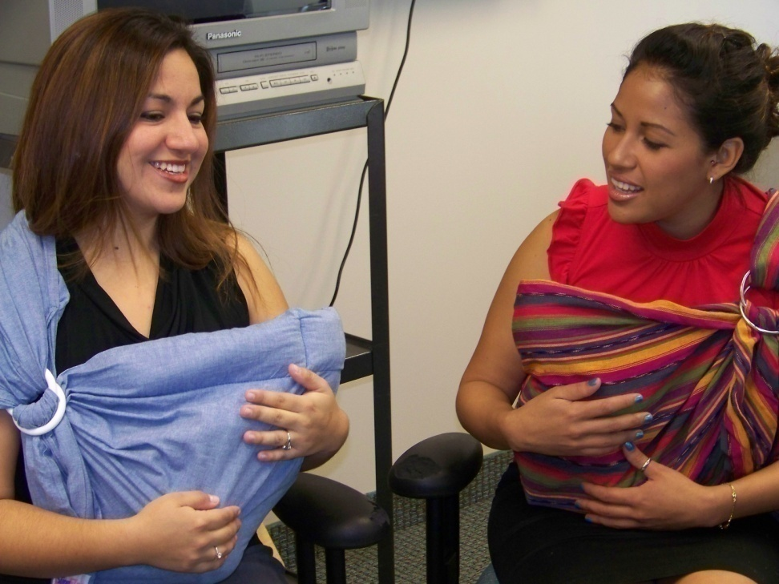
How Affirmation Helps Build Connection
Builds confidence and self-respect
Helps mothers relax and safe, which builds trust in you and your information
Does not imply agreeing with her choices
Miami-Dade WIC Program, Miami, FL

Slide 22
Ways To Affirm
Agree with her
Show her she’s not alone
Read between the lines
Shine the spotlight
Show her how she is a good mother
Handout 3.3: “Affirmation Snapshot”

Slide 23
The Gift of Affirmation
Handout 3.4: “The Gift of Affirmation”

Slide 24

Practice: Affirming New Mothers
My breasts are too small. The baby will starve.
I’d be too afraid to breastfeed since I smoke.
I don’t want my dad to see me breastfeed.
I’m afraid breastfeeding will be too painful.
I want some formula, too, since I don’t think I’m making enough milk.
She wants to nurse all the time!

Slide 25
Show Me!
DVD: “Show Me Video Vignettes”
Handout 3.5: “Show Me Video Vignette – Using 3-Step to Counsel New Mothers”

Slide 26
Role Plays
Handout 3.6: “Role Play Scenarios”

Slide 27
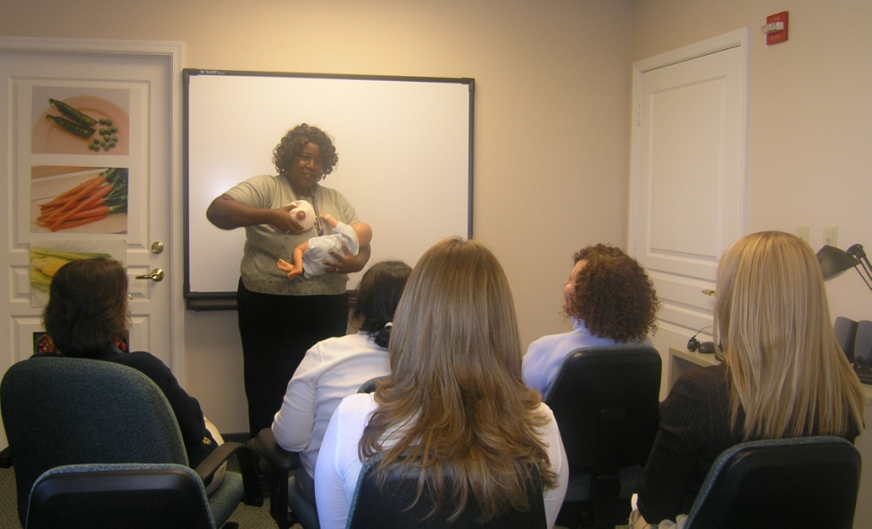
Step 3: Education
Adults learn best when you:
Target info to mother’s concerns
Feed information in small bites
Give 2-3 simple options
Keep it simple
Reinforce the information
Miami-Dade WIC

Slide 28


Start With Heart
Tie messages to what mothers value:
Being close to baby
Being good mothers
Sense of success
Happiness
Having their children love them
State WIC Resources
Pennsylvania WIC State Agency

Slide 29

What’s in YOUR Junk Drawer?
Handout 3.7: “Replacing Worn-Out Tools”

Slide 30

More Tools for Connection The WIC Welcome
The power of “first impressions” to WIC
Rolling out the welcome
Smile, helpful attitude
Non-judgmental approach
Role of clerks
Clinic environment
Hialeah West WIC, Miami, FL

Slide 31
Clerical Language Supporting Breastfeeding
“You’re a great mom for breastfeeding.”
“Look at how your baby is looking at you. He definitely knows you’re his mom!”
”WIC has some great new food packages for breastfeeding moms! The nutritionist will tell you more about them today!”
“WIC has peer counselors, WIC moms just like you, who you can talk to about making breastfeeding fit into our life.”
Handout 3.8: “Clerical Language Supporting Breastfeeding”

Slide 32
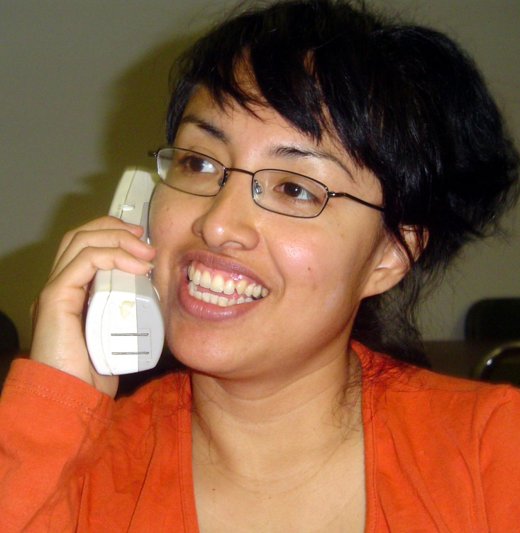
Tools for Connection Body Language
Words
Facial expressions/body language
Tone of voice

Slide 33

Setting the Tone
CLERK:
A breastfeeding mother demands formula today because she is running out of milk.
CERTIFIER:
A pregnant teen is very shy and gives little information when you ask her about her thoughts on breastfeeding.
A postpartum mother looks worn and haggard when she enters your office with her 1-week-old baby.
WIC MANAGER:
A clerk in your office complains that a very rude participant insulted her as she left. The clerk begins to cry.

Slide 34
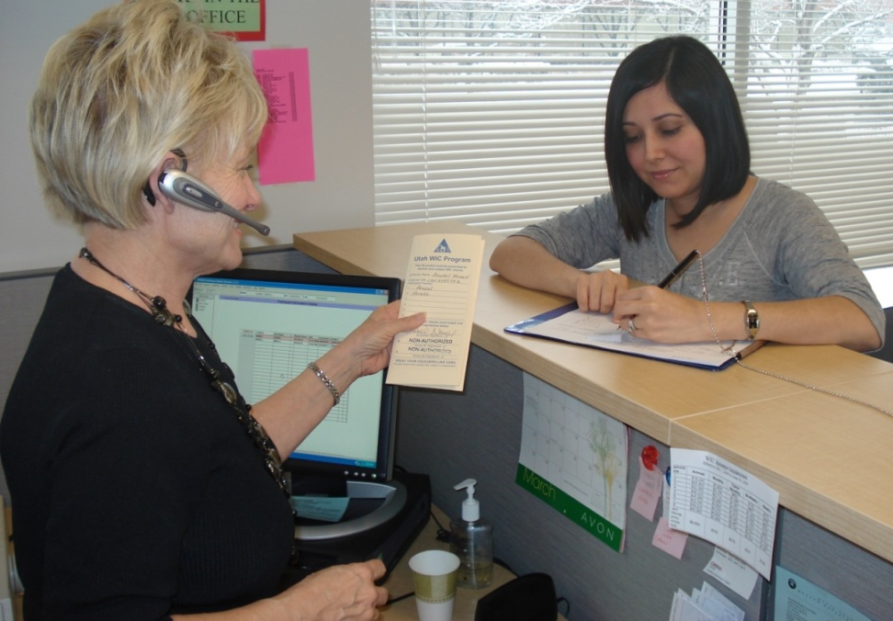
Using 3-Step in Challenging Situations
Ask open-ended questions to explore concerns
Show empathy through affirmation
Respect the mother’s decisions
Utah WIC

Slide 35
What About Mothers From Other Cultures?
Be careful about broad cultural assumptions
Respect beliefs, even if different from your own
Affirm each mother

Slide 36
Planting Seeds
Seeds take varying amounts of time to take root and grow
Mothers require different levels of support
Our job: Faithfulness in planting the seeds and watering them with support

Slide 37
Application To Practice
Handout 3.9: “Application To Practice: Communicating Connection”

Slide 38

Grow Your Breastfeeding Skills
“My Goals for Breastfeeding Support”
Goal-Setting Flower

